Slide 1

Motional Control of Loudspeakers
Sujit Malde
3rd Year Project Symposium

Slide 2
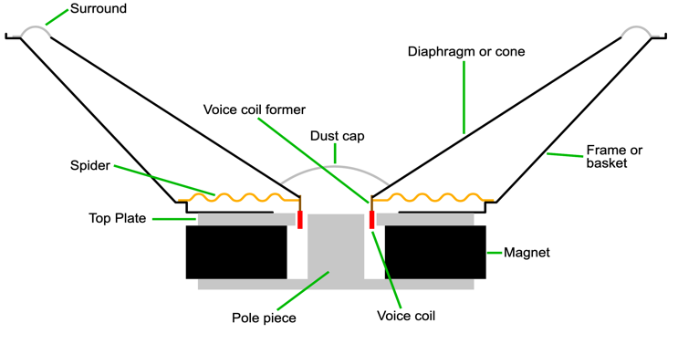

Slide 3
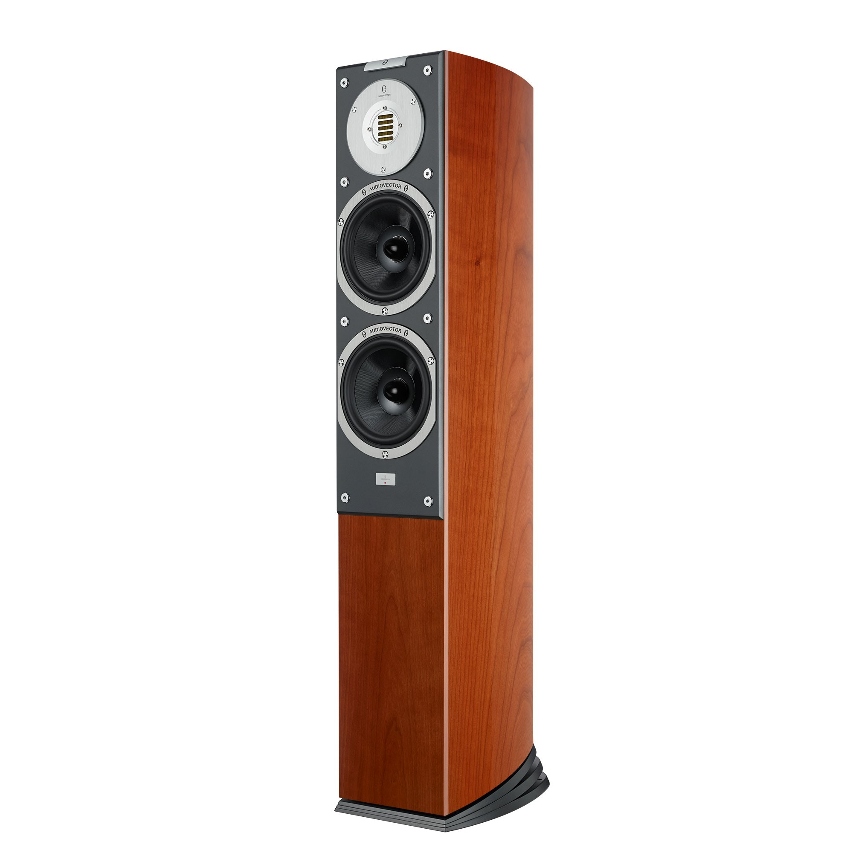
Background
Loudspeakers should be:
Small
Efficient
Linear
Linearity is hard to achieve
Most consumers don’t have access to good sound quality
Subwoofers perform the worst as proven by mathematics
https://audiovector.com/sr-3-avantgarde-arrete.html

Slide 4
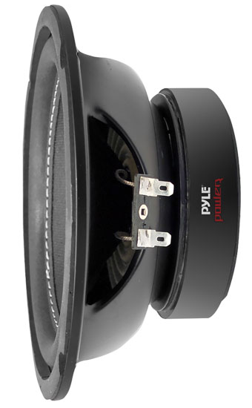
Background
Electronic controllers are the solution.
Open-loop controllers e.g. EQ filters are well-known and used by enthusiasts
Closed-loop controllers only used experimentally
Compare between each type to determine which is best
https://www.thompsonsltd.co.uk/touring-and-leisure/plpw6d-pyle-plpw6d-6.5-600-watt-dual-voice-coil-4-ohm-subwoofer.html

Slide 5
Aims
Design & build an enclosure – one that helps to improve the quality of sound if possible
Compare controlled subwoofer setups against non-controlled setups and determine which controller is the best.
Keep the costs down.

Slide 6


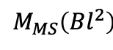

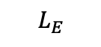

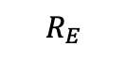
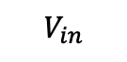

Theory
Mass of cone and air
Mechanical resistances
Compliance of cone suspension / of box
$$R_{E}$$
$$L_{E}$$
$$I$$
$$V_{in}$$
$$M_{MS}\left(Bl^{2}\right)$$
$$\frac{C_{MS}}{{\left(Bl\right)}^{2}}$$
$$\frac{{\left(Bl\right)}^{2}}{R_{MS}}$$
$$\frac{C_{B}}{{\left(Bl\right)}^{2}}$$
$$\frac{{\left(Bl\right)}^{2}}{R_{B}}$$
Voice coil circuit
Driver mechanical equivalent circuit
Box mechanical equivalent circuit
Mechanical circuit is a referred transformer secondary with turns ratio Bl
Useful for SPICE/MATLAB
Not easy information for end-users to digest
Some can’t be measured, manufacturers don’t give any of these values on datasheets
Thiele/Small parameters used instead

Slide 7
Theory cont.
VAS Volume of air that, when compressed to 1 cm³, exerts the same force on the cone as the cone suspension | Z_{nom} Voice coil nominal impedance | D Cone diameter
Q_{M} Mechanical circuit Q-factor | Q_{E} Electrical circuit Q-factor | Q_{T} Total circuit Q-factor
f_{S} Driver resonant frequency | Bl Force-current constant | X_{MAX} Maximum cone excursion

Slide 8
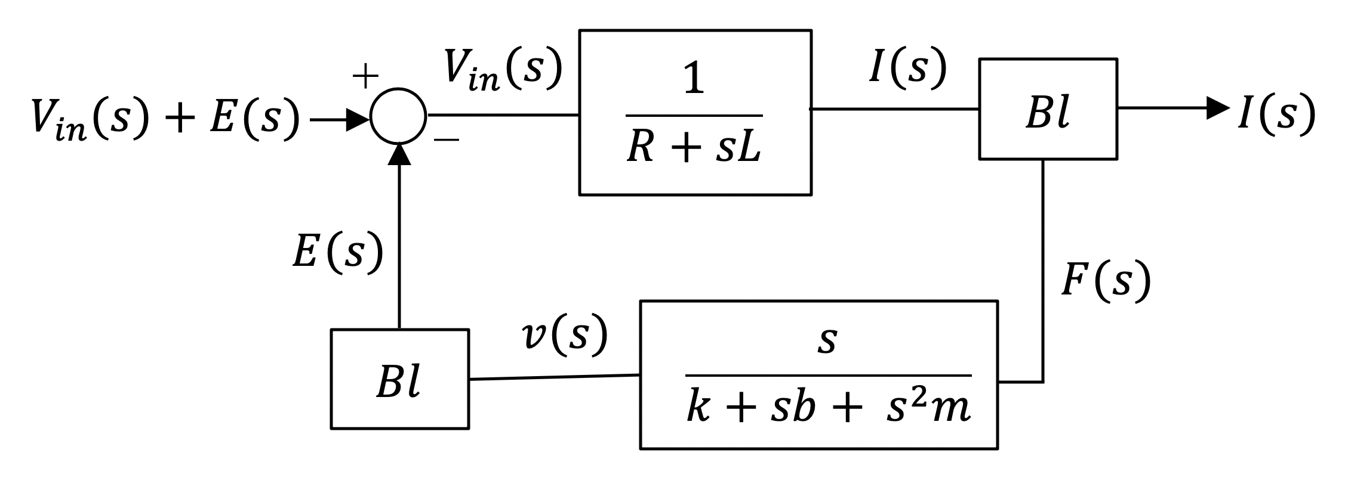
Theory cont.
Closed-loop is more desirable than open-loop
Open- and closed-loop controllers are inflexible but…
Closed-loop control theory allows for:
State observers (obtain values for normally unmeasurable equivalent circuit parameters)
Disturbance observers (measure disturbances that affect system performance such that they can be eliminated)
Estimators (predict how certain loudspeaker parameters change over time)

Slide 9
Methodology
Choose a subwoofer. Ideally cheap and small to prove that it’s the technology that makes the system sound good, not the build quality of the system alone. Pyle PLPW6D → cheap, small, dual voice-coils = more freedom down the road

Slide 10
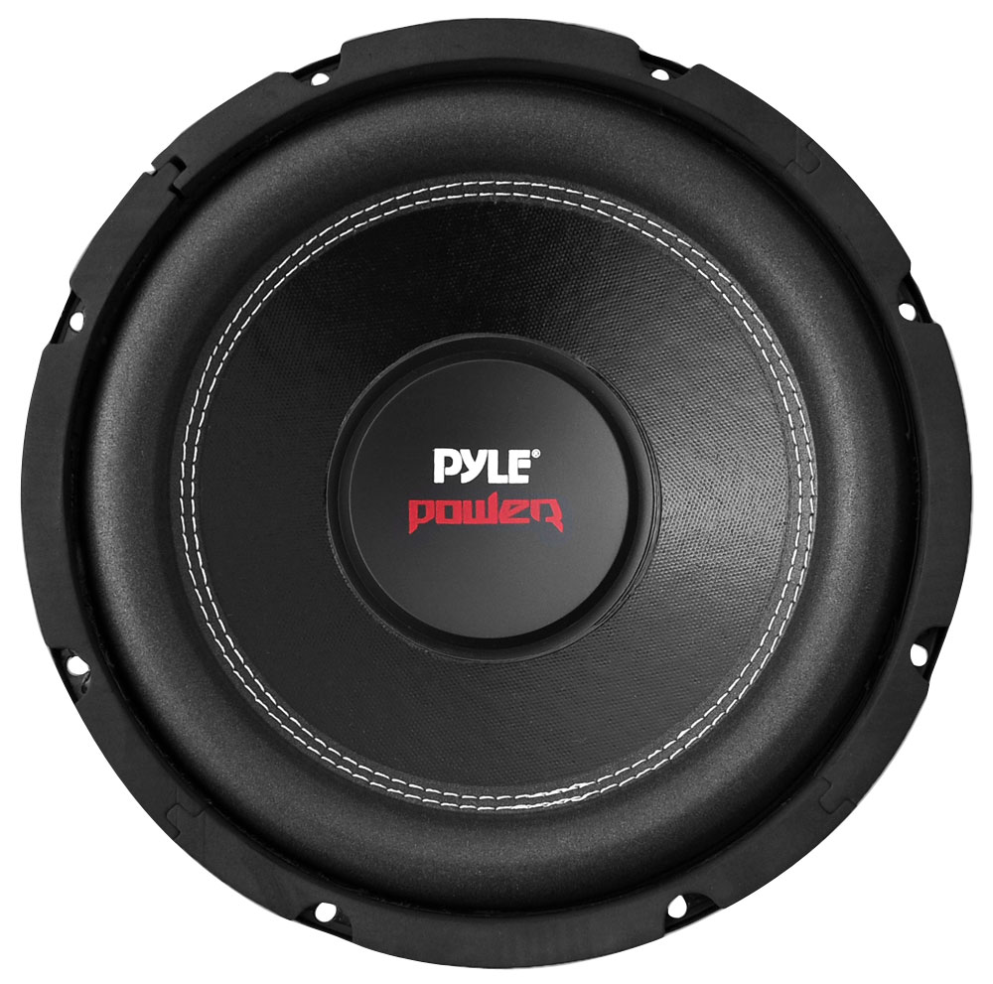
Methodology
Pyle PLPW6D:
Cheap (RRP $40)
Small (6-inch diameter)
Dual voice coils (more freedom of design)
https://www.thompsonsltd.co.uk/touring-and-leisure/plpw6d-pyle-plpw6d-6.5-600-watt-dual-voice-coil-4-ohm-subwoofer.html

Slide 11
Methodology
Choose a subwoofer. Ideally cheap and small to prove that it’s the technology that makes the system sound good, not the build quality of the system alone. Pyle PLPW6D → cheap, small, dual voice-coils = more freedom down the road
Impedance measurements for unmounted subwoofer.

Slide 12
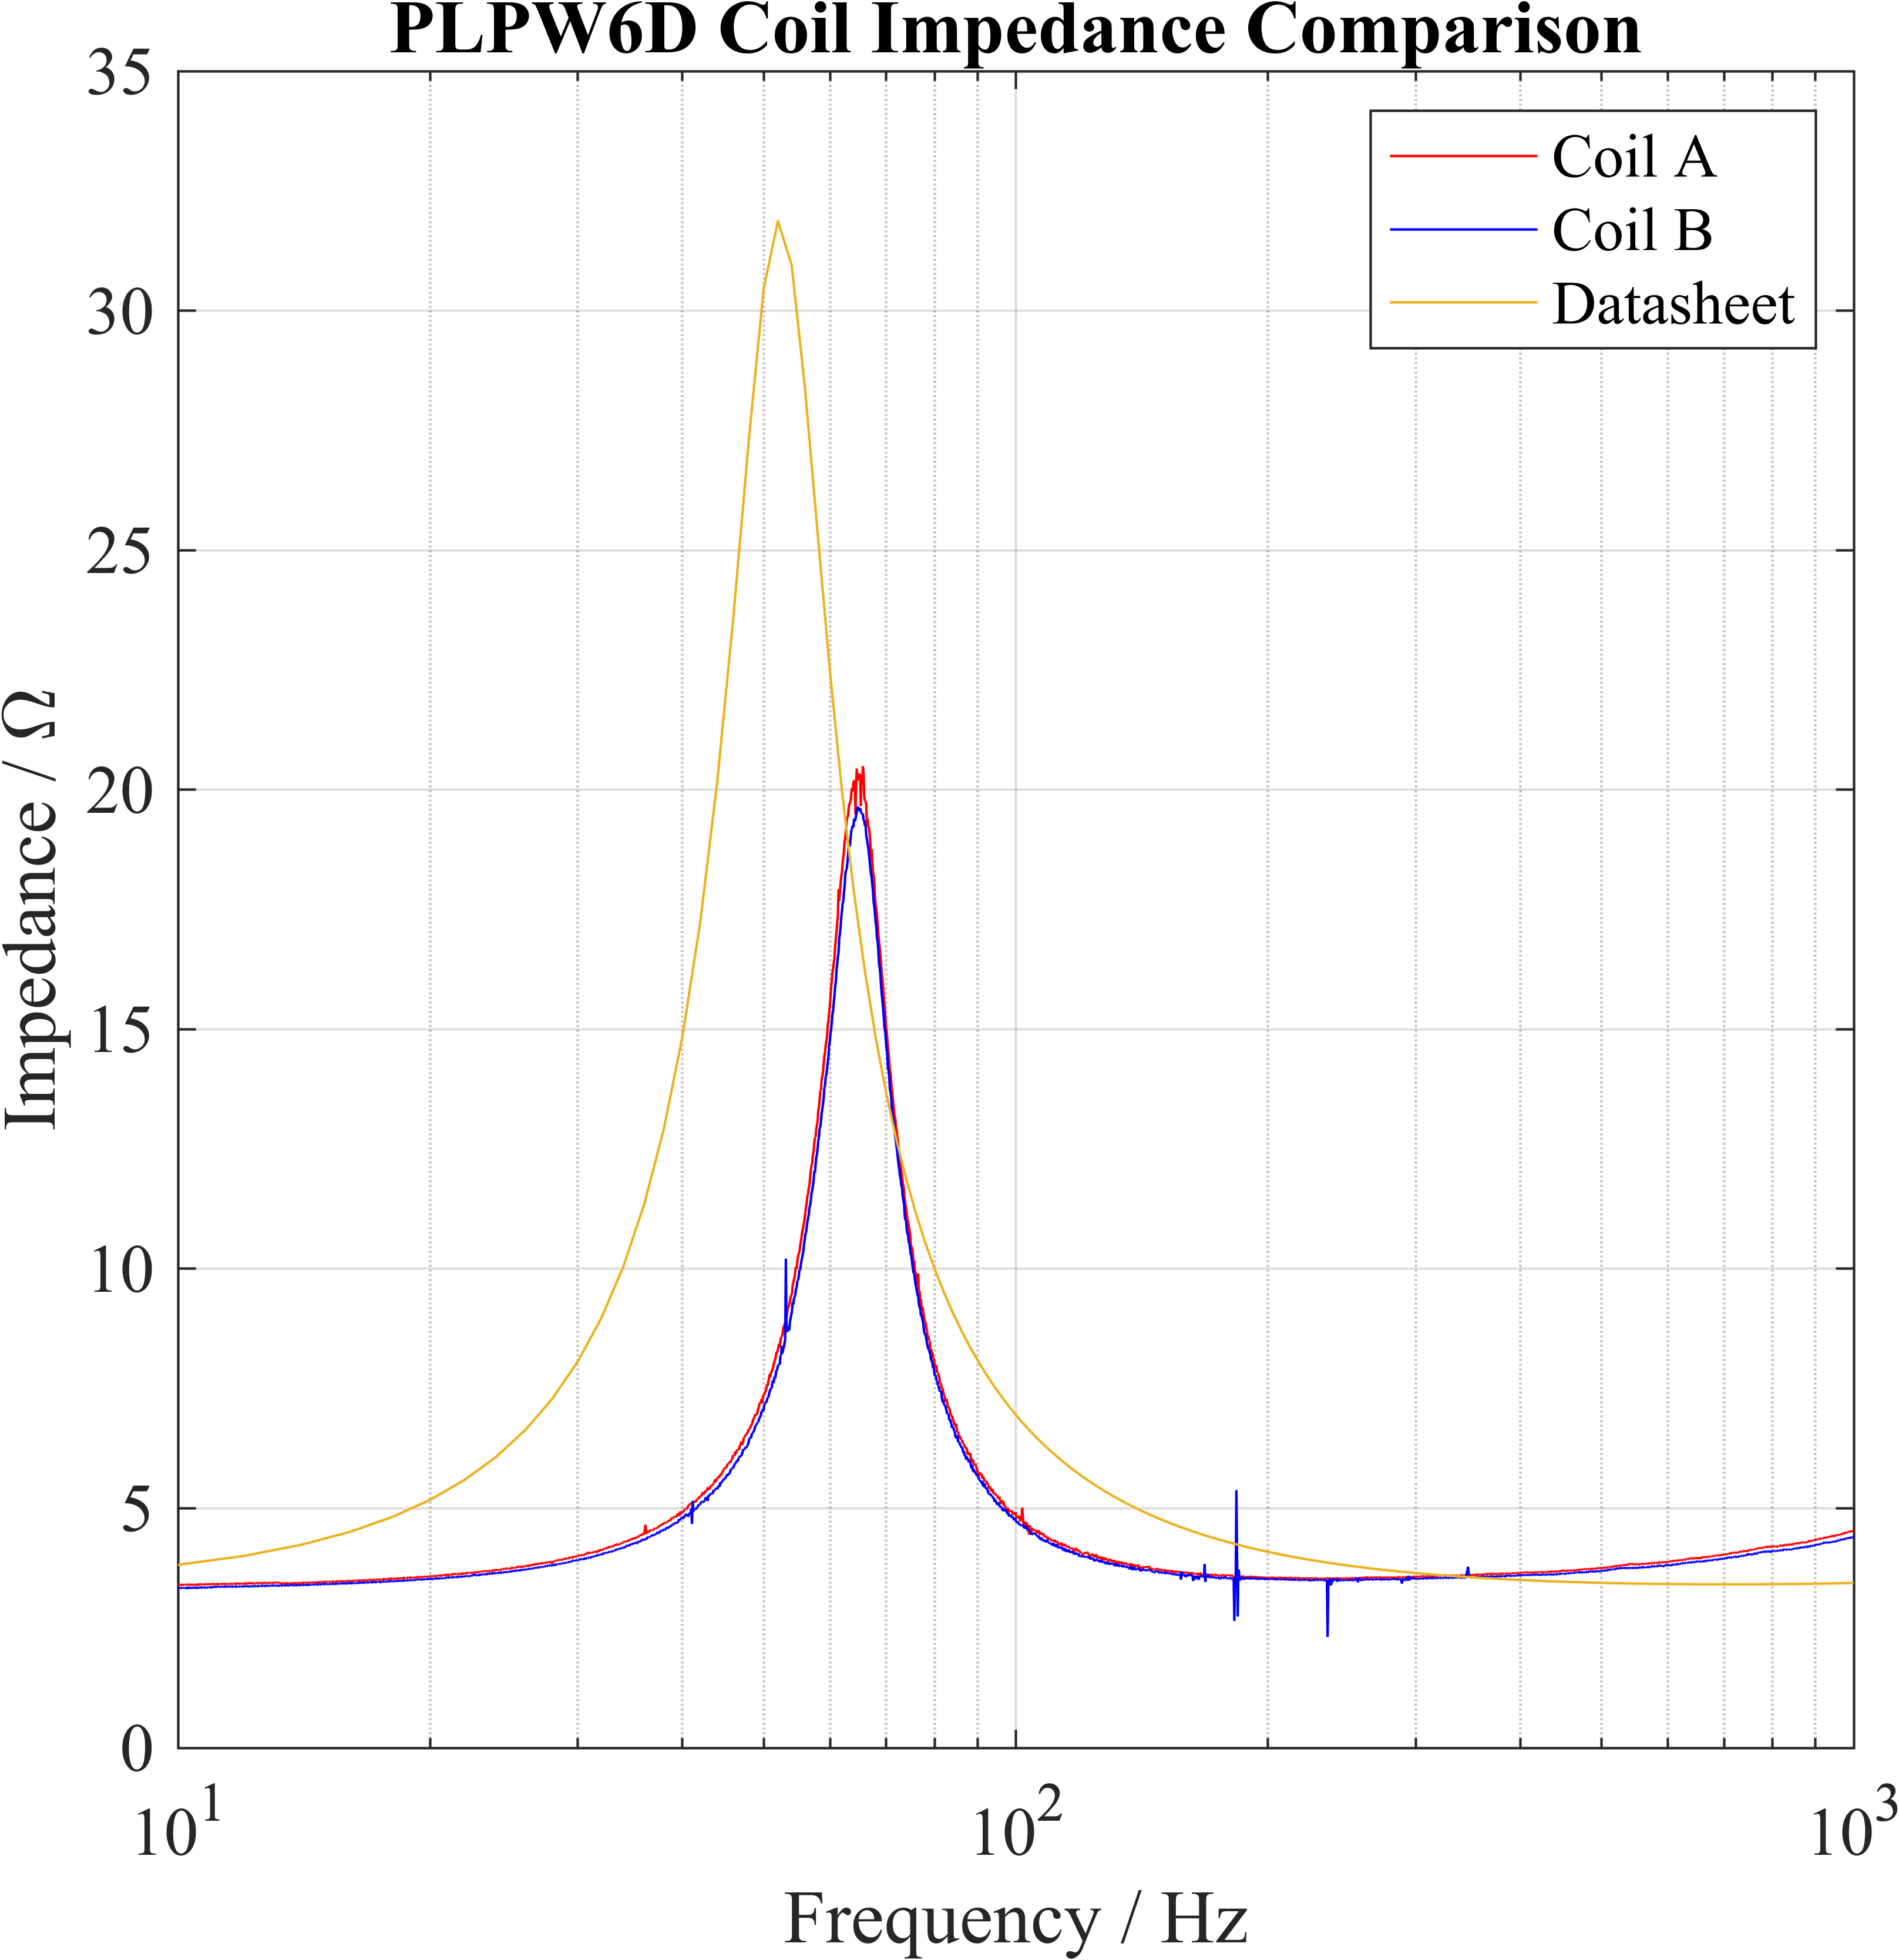
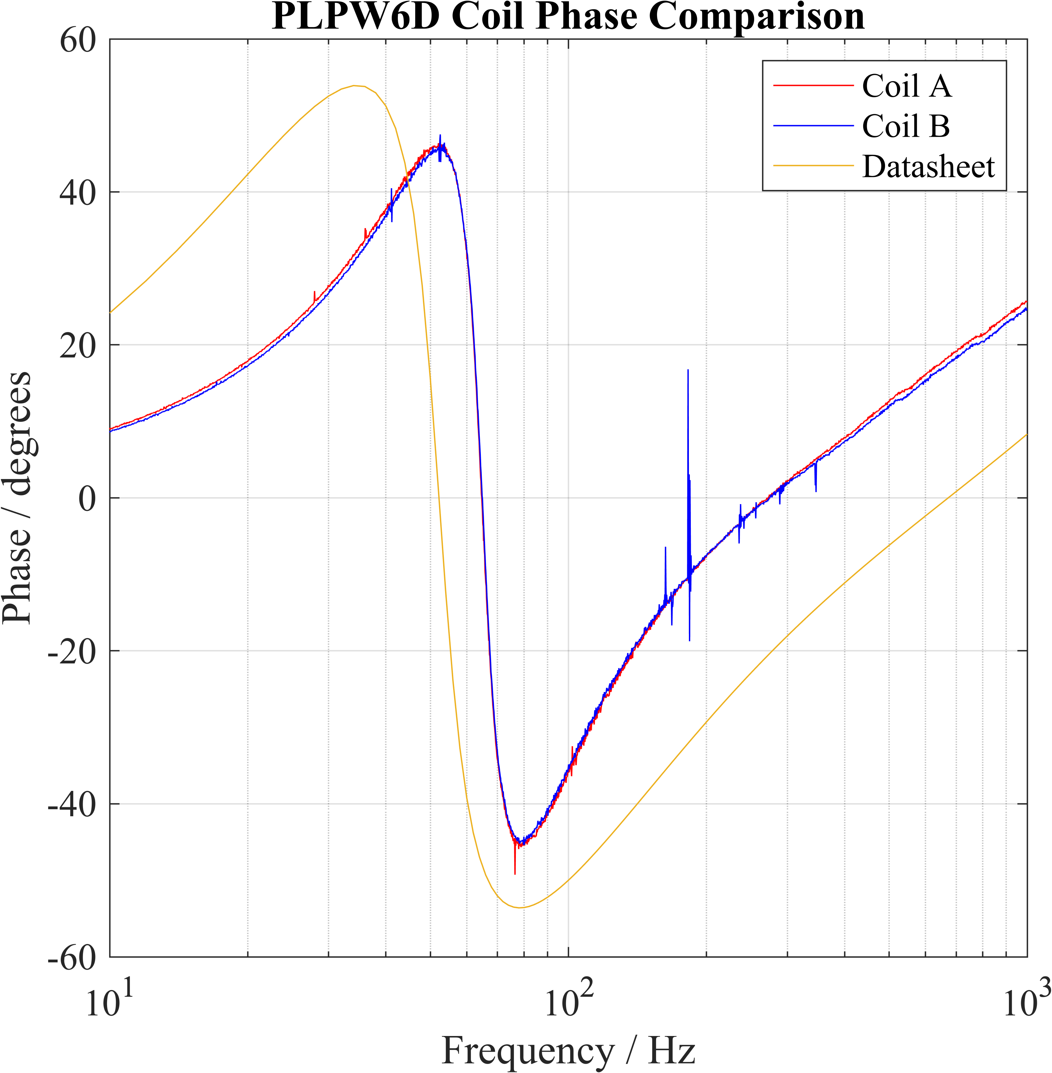
Methodology

Slide 13
Methodology
Choose a subwoofer. Ideally cheap and small to prove that it’s the technology that makes the system sound good, not the build quality of the system alone. Pyle PLPW6D → cheap, small, dual voice-coils = more freedom down the road
Impedance measurements for unmounted subwoofer.
Enclosure design: balance between f_{S}, power requirements, box size
Lower f_{S} = bigger box, more power to push larger volumes of air
Smaller box = higher f_{S}

Slide 14
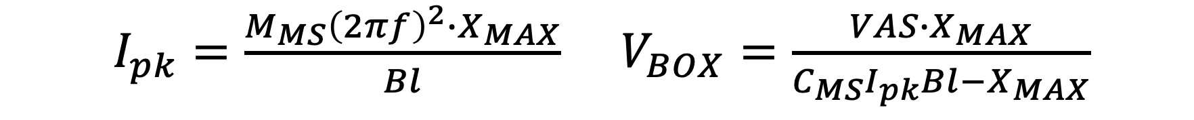
Methodology
$I_{pk}=\frac{M_{MS}{\left(2πf\right)}^{2}∙X_{MAX}}{Bl}$ $V_{BOX}=\frac{VAS{∙X}_{MAX}}{C_{MS}I_{pk}Bl−X_{MAX}}$

Slide 15
Methodology
Choose a subwoofer. Ideally cheap and small to prove that it’s the technology that makes the system sound good, not the build quality of the system alone. Pyle PLPW6D → cheap, small, dual voice-coils = more freedom down the road
Impedance measurements for unmounted subwoofer.
Enclosure design: balance between f_{S}, power requirements, box size
Lower f_{S} = bigger box, more power to push larger volumes of air
Smaller box = higher f_{S}
Enclosure construction.

Slide 16
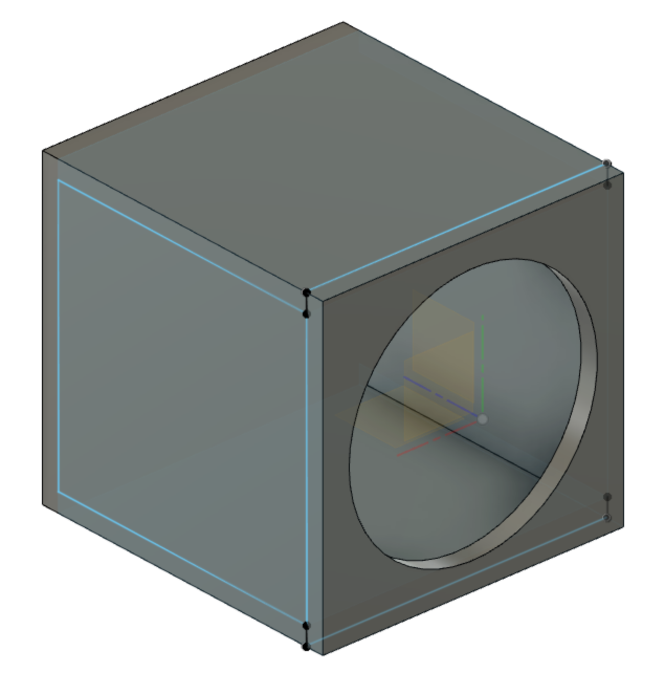
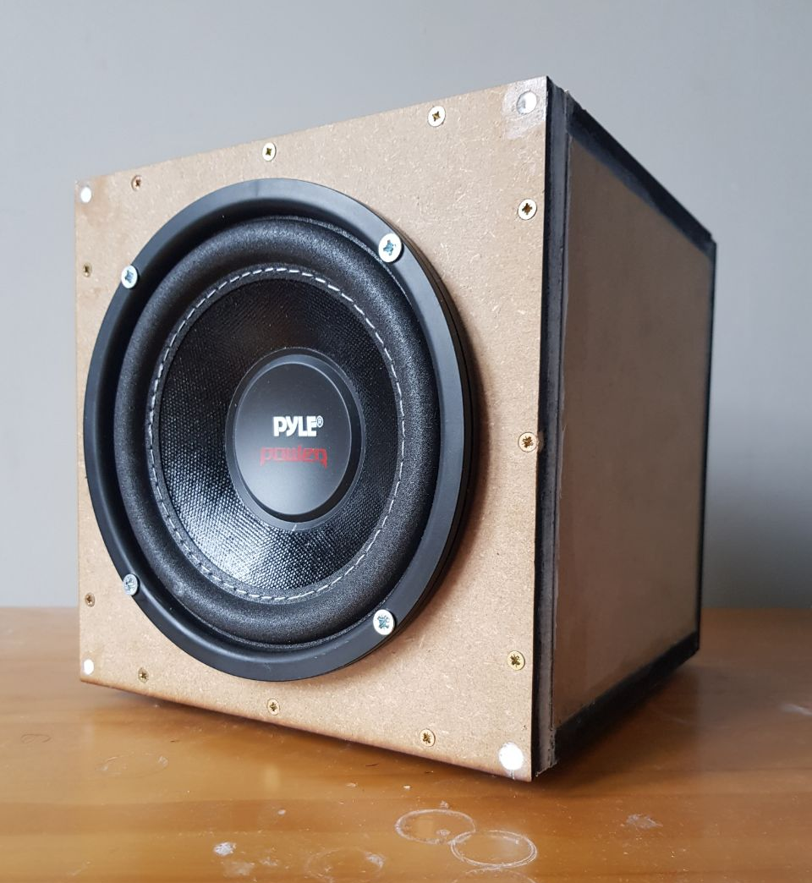
Autodesk Fusion 360 model used for help
12 mm MDF
Wood cut with laser cutter
PVA joined, secured with 3 mm ⌀ screws
Box/finger/other joints not used – air leakage possibility
Silicone sealant
Banana ports mounted on rear

Slide 17
Methodology
Impedance measurements pt. 2.
Choose open-loop compensator.

Slide 18
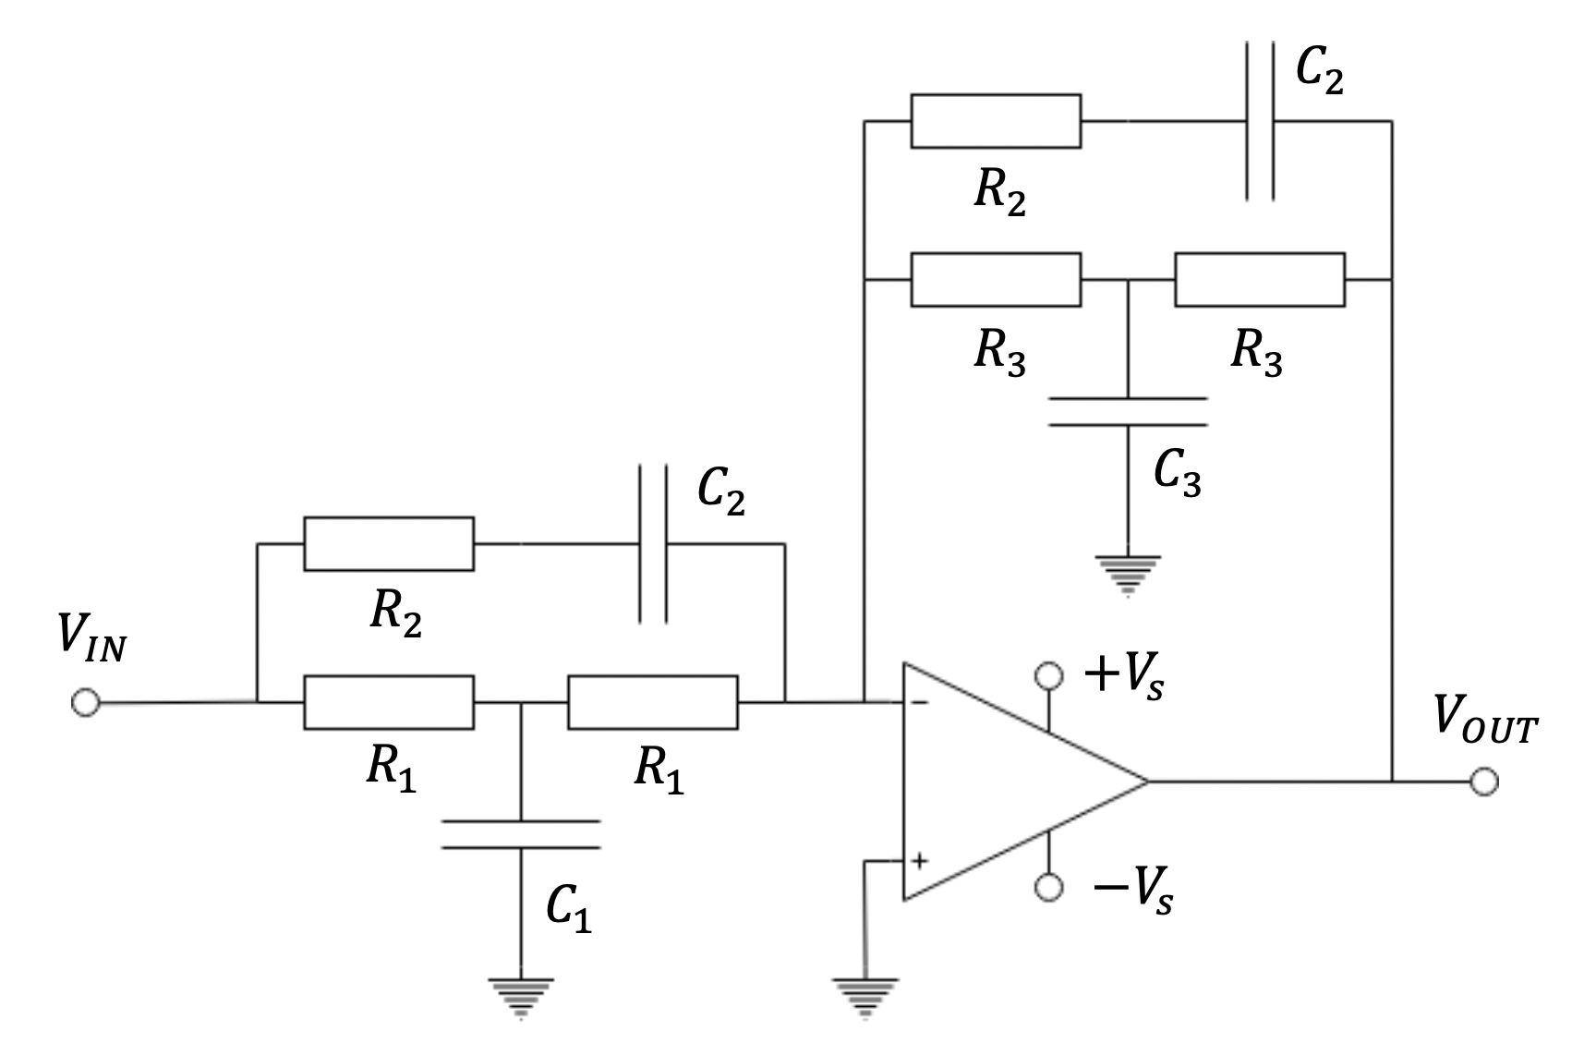
+V_{S} = 15 V, –V_{S} = –15 V
C₁ = 197 nF, C₂ = 69 nF, C₃ = 62 nF
R₁ = 15.4 kΩ, R₂ = 13.3 kΩ, R₃ = 442 kΩ

Slide 19
Methodology
Impedance measurements pt. 2.
Choose open-loop compensator.
Choose closed-loop controllers.

Slide 20
Method cont.
Impedance measurements pt. 2
Choose open-loop compensator
Choose closed-loop controllers
Tune controllers using 2nd round impedance measurements

Slide 21
Method cont.
Due to COVID-19, many simulations were conducted in lieu of actual controllers being built and tuned. As such, the results must be considered as guidelines for the presented methodology, to be used as validation in the case where this project is undertaken in real life. 3 Simulink models were designed to collect data about each system setup.

Slide 22
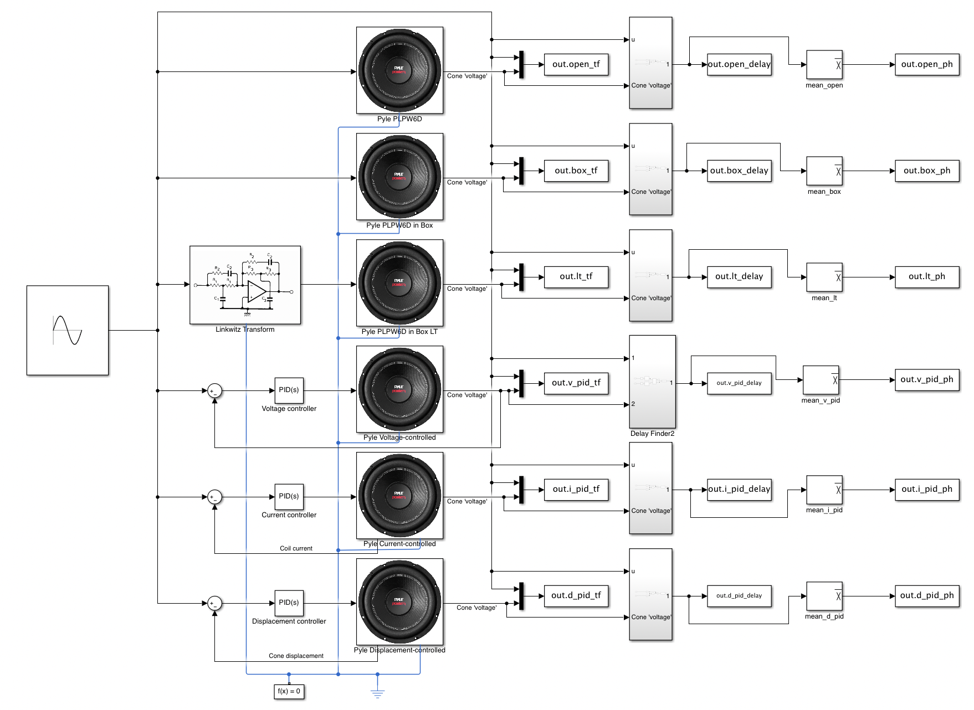

Slide 23
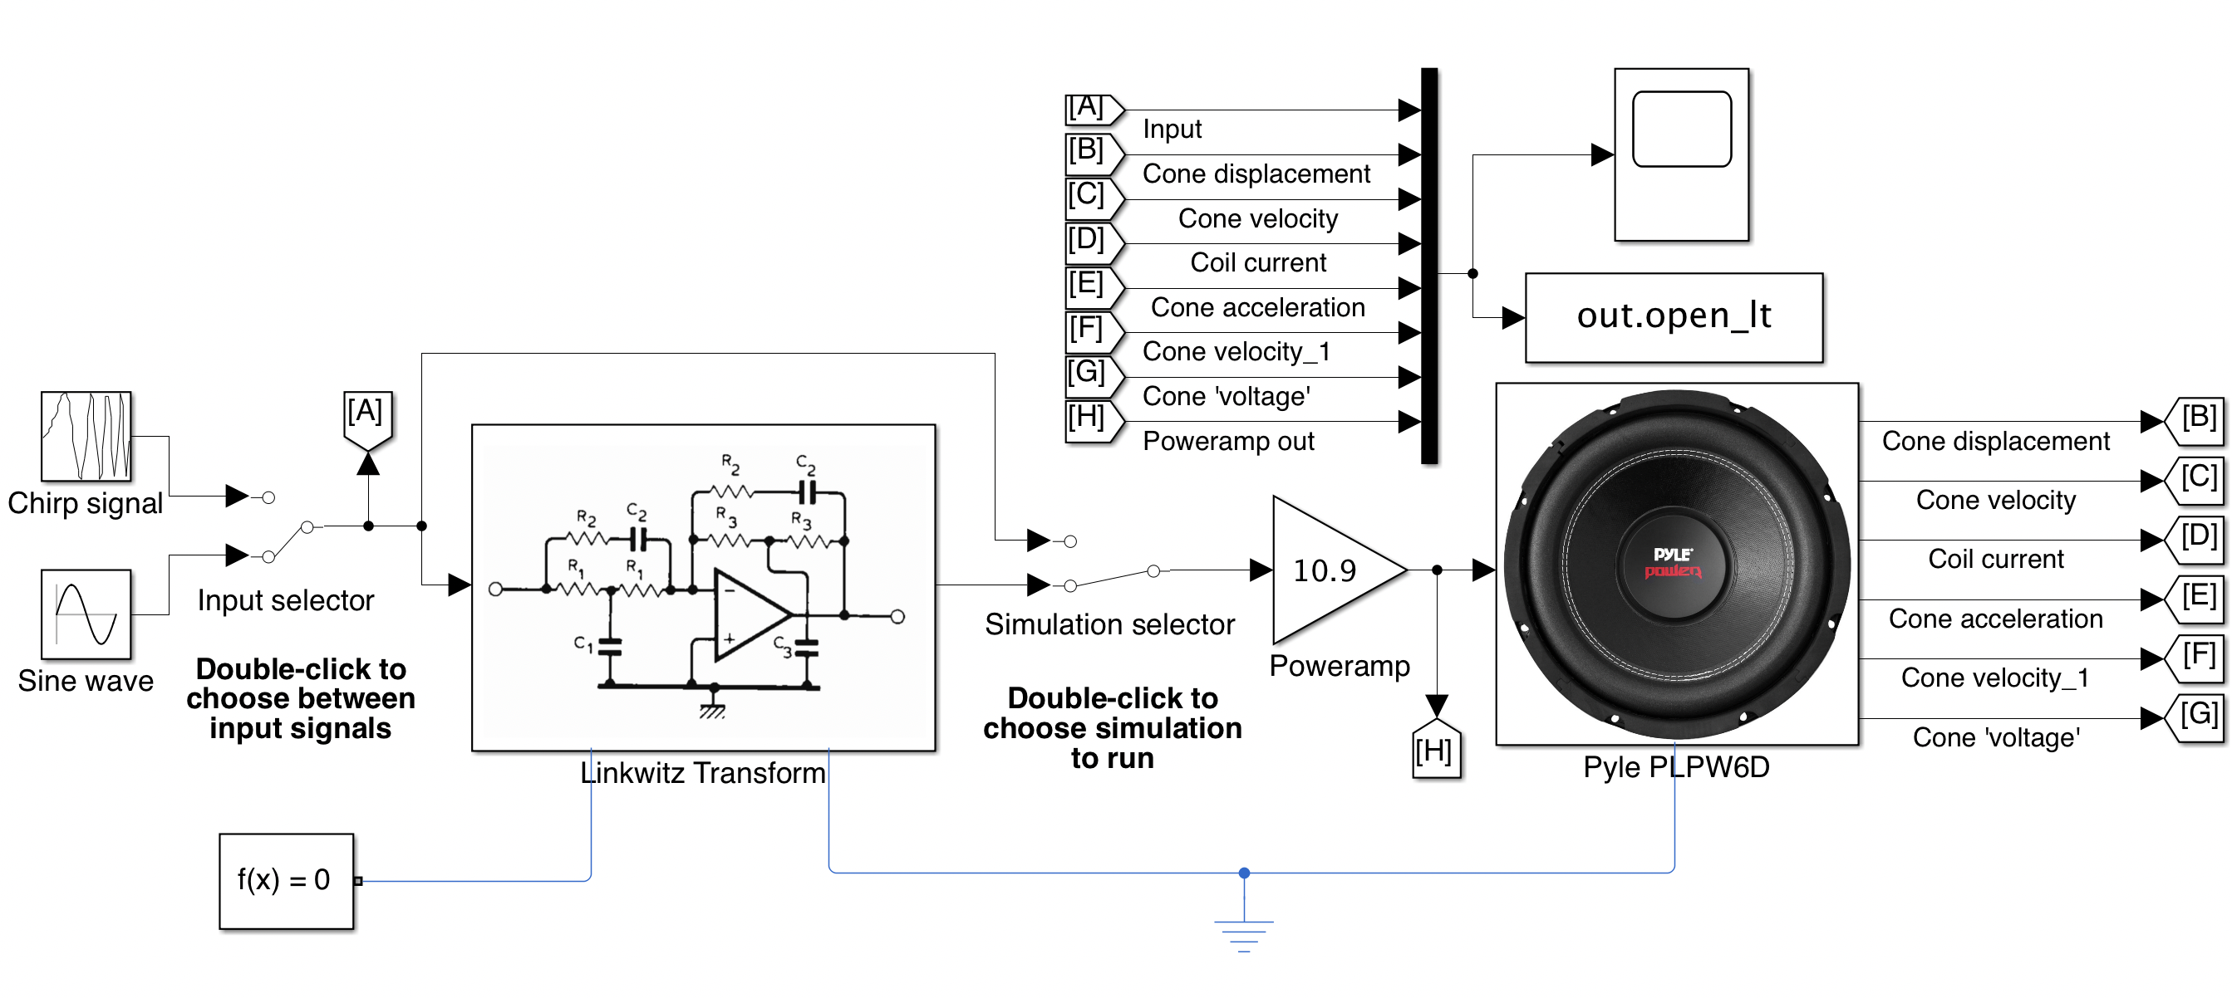
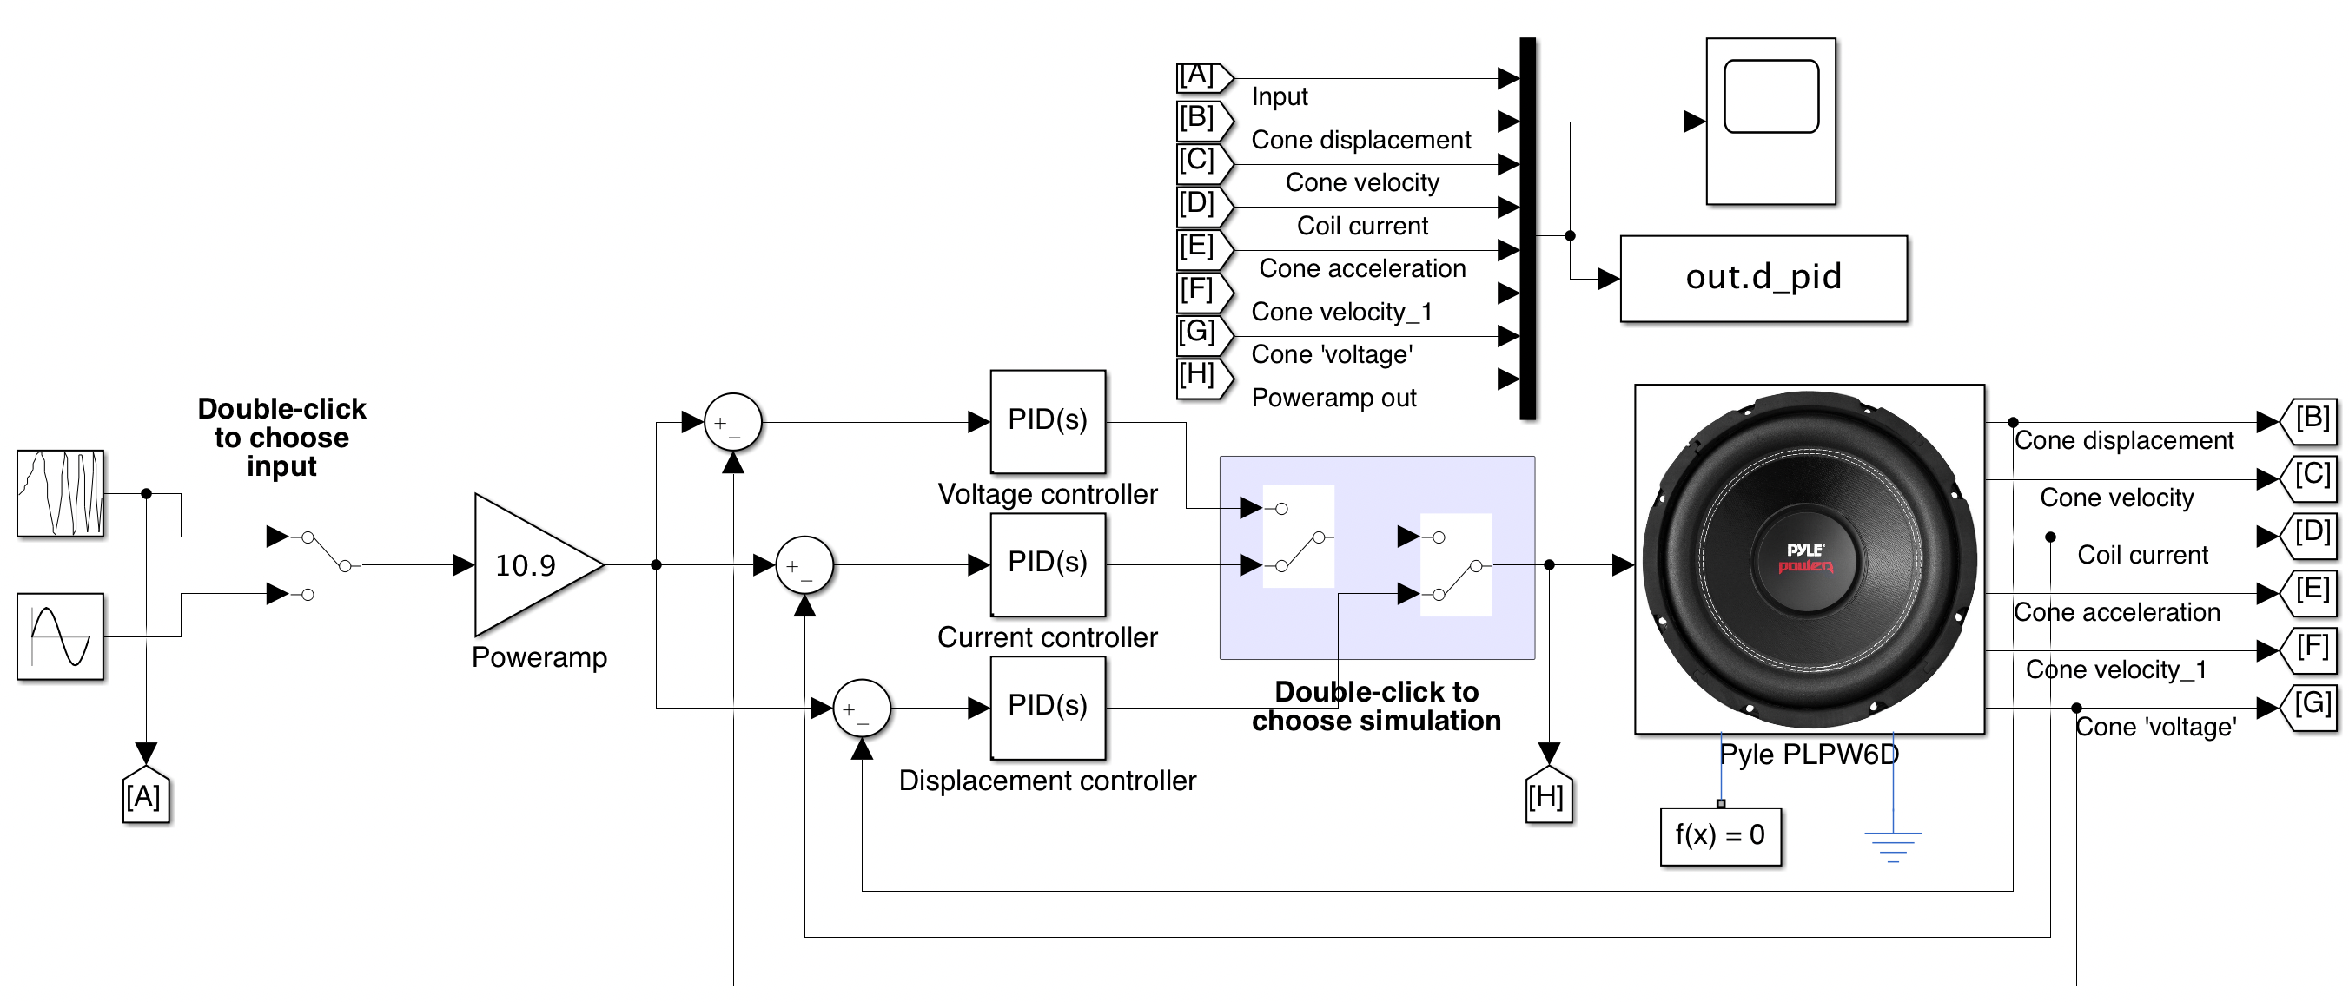

Slide 24
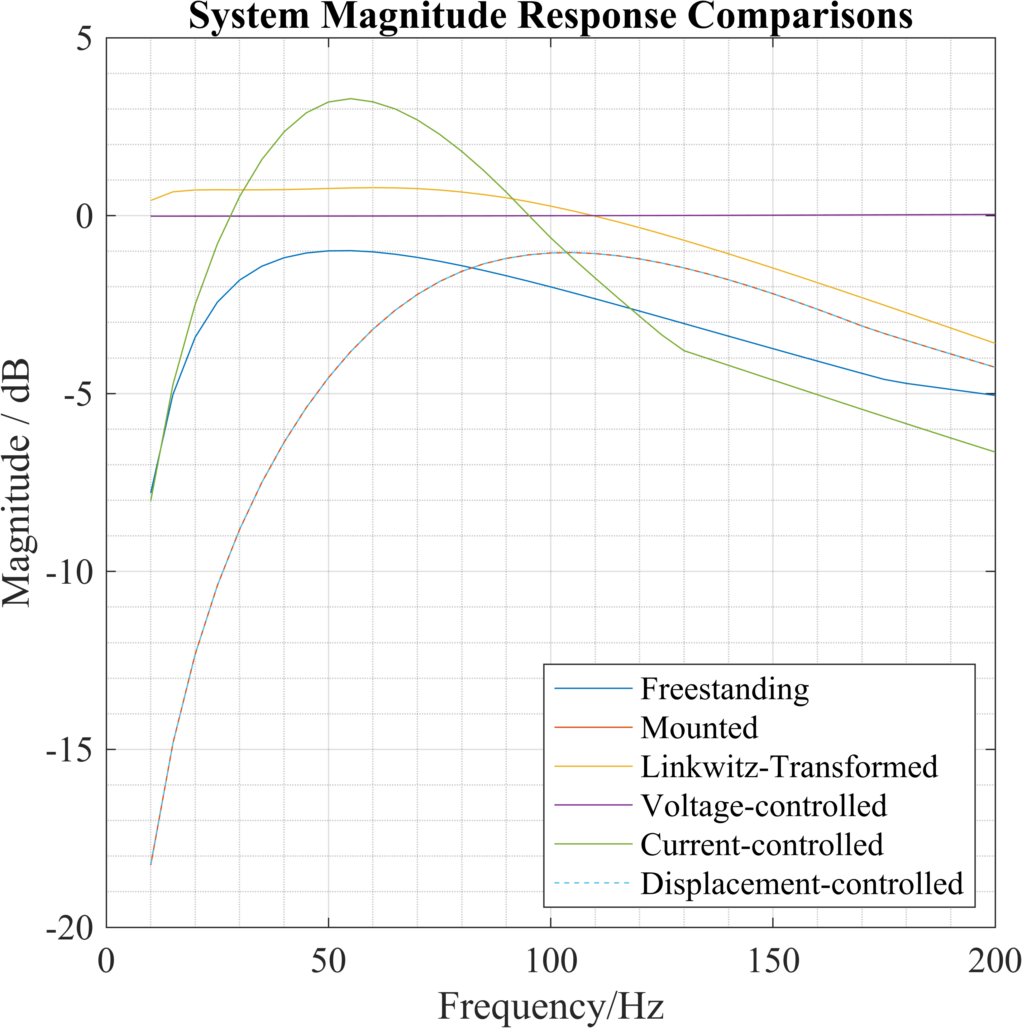
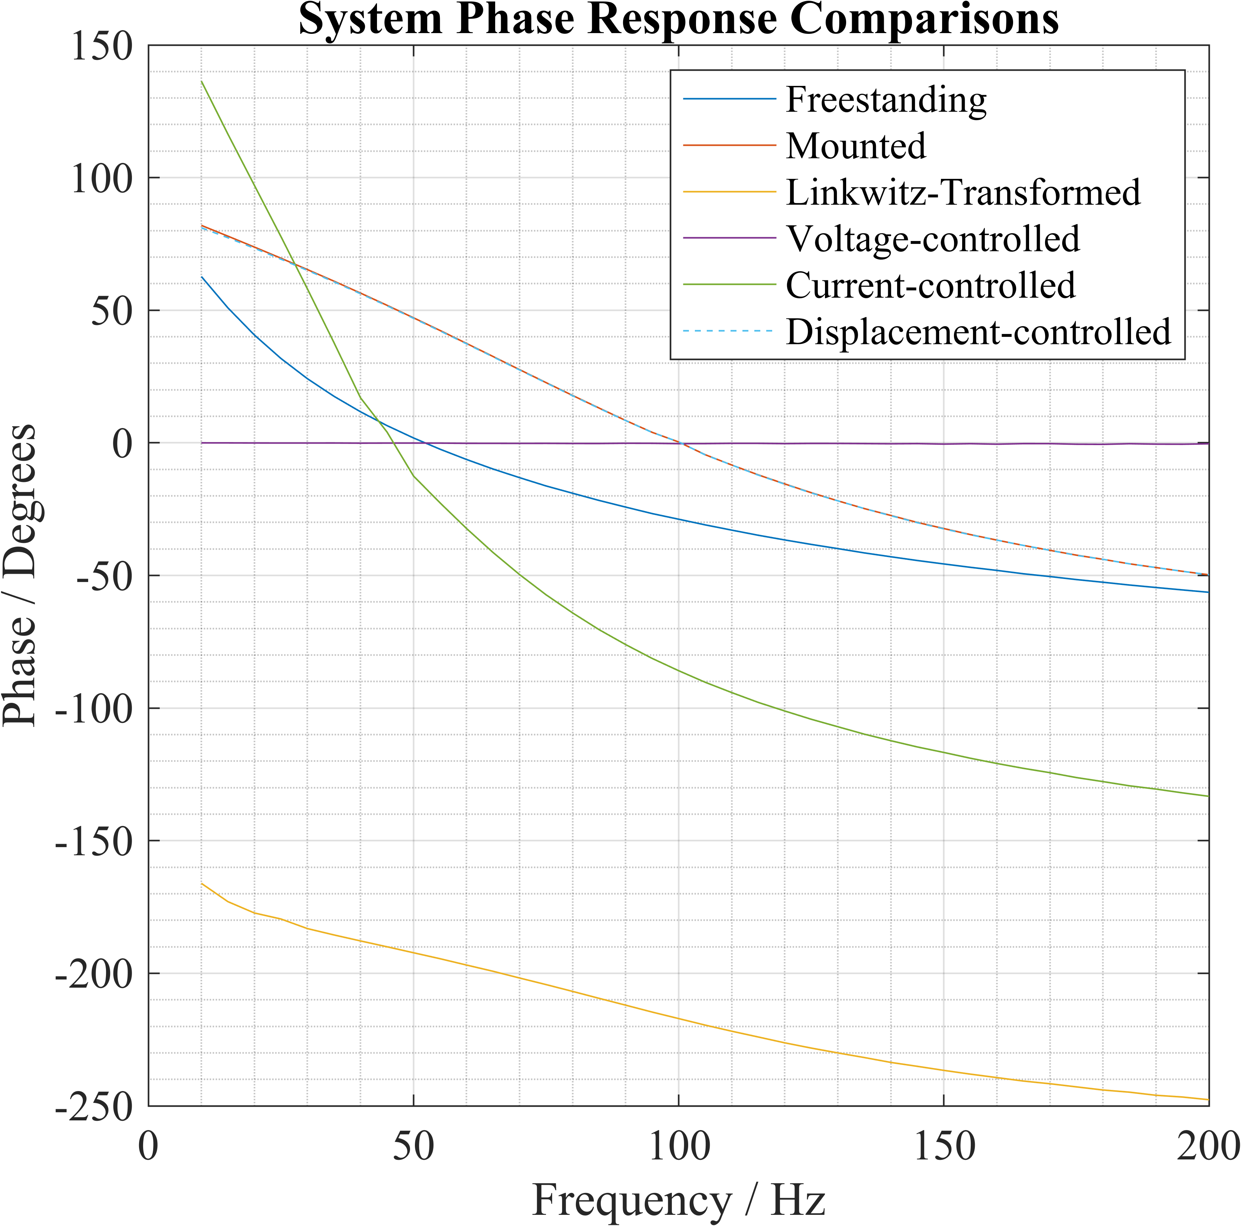
Results

Slide 25
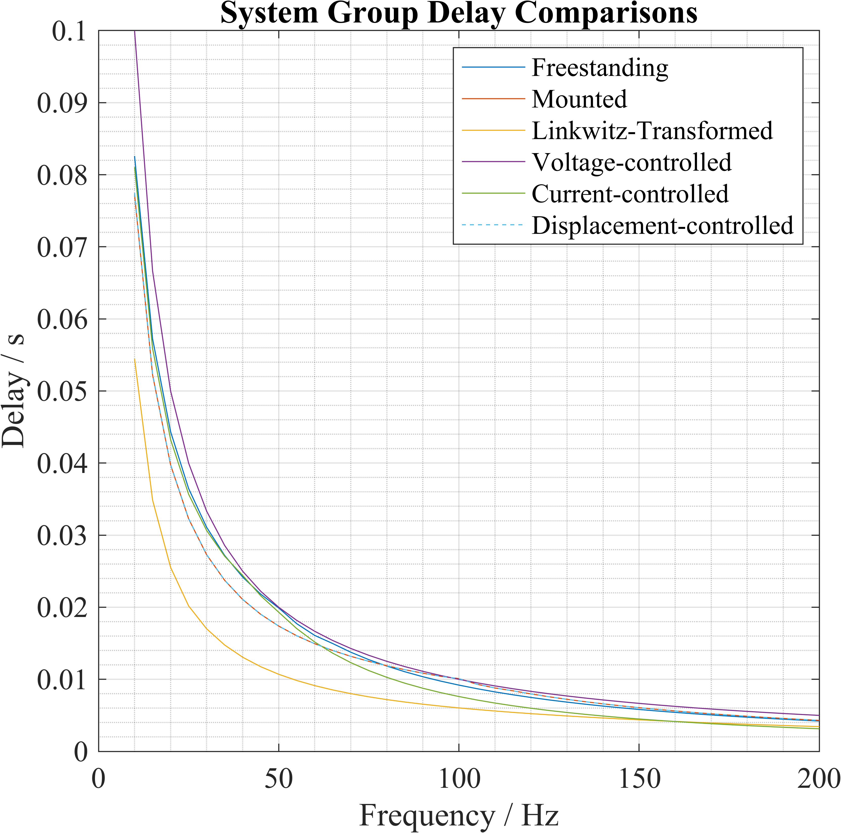

Slide 26
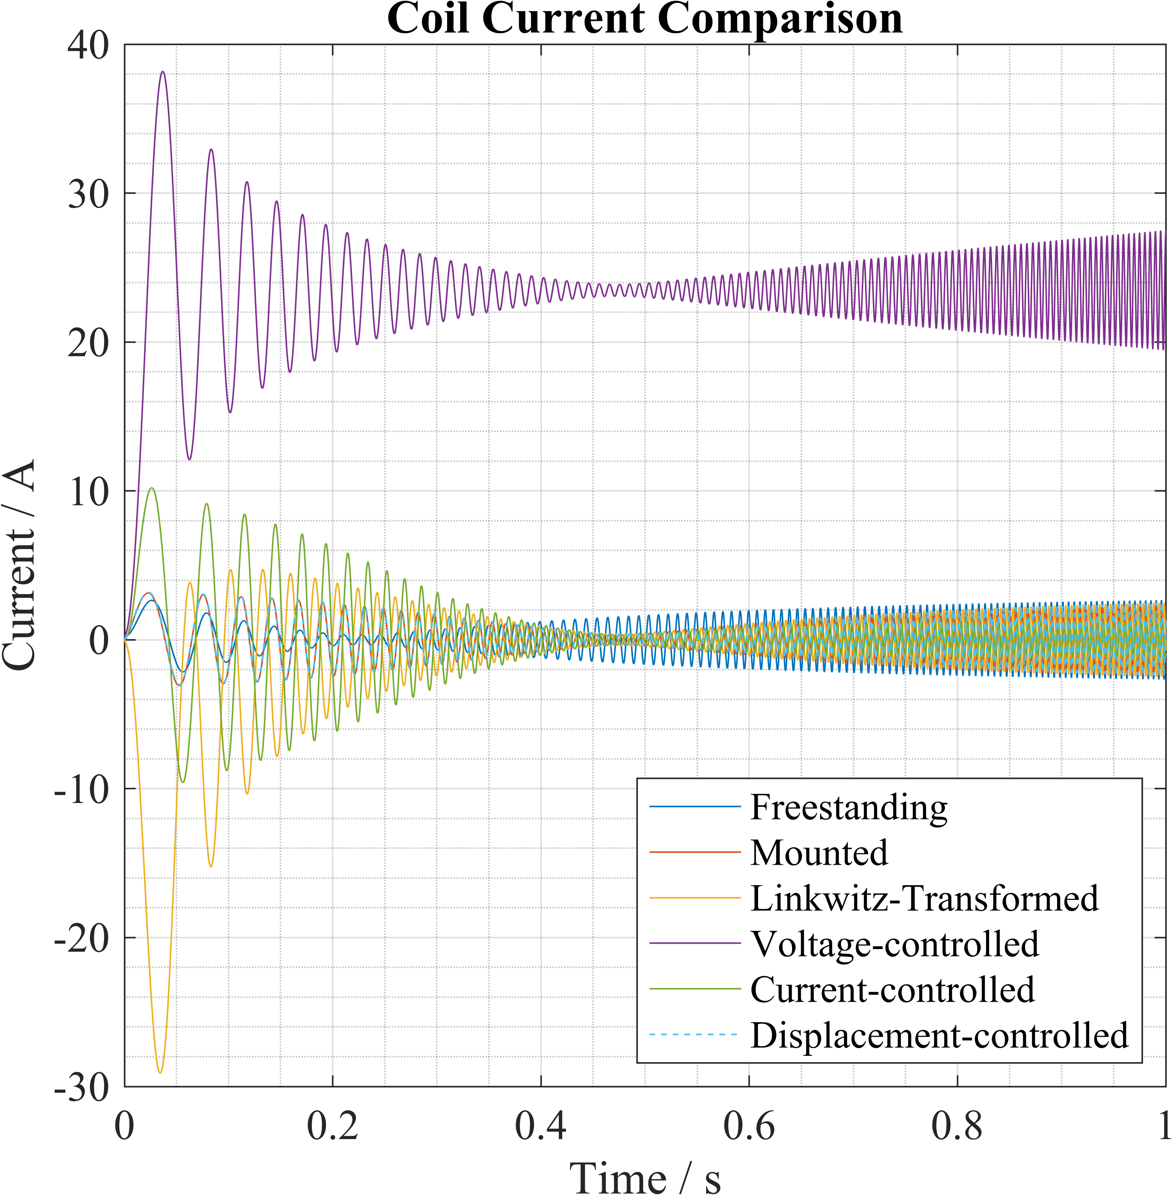
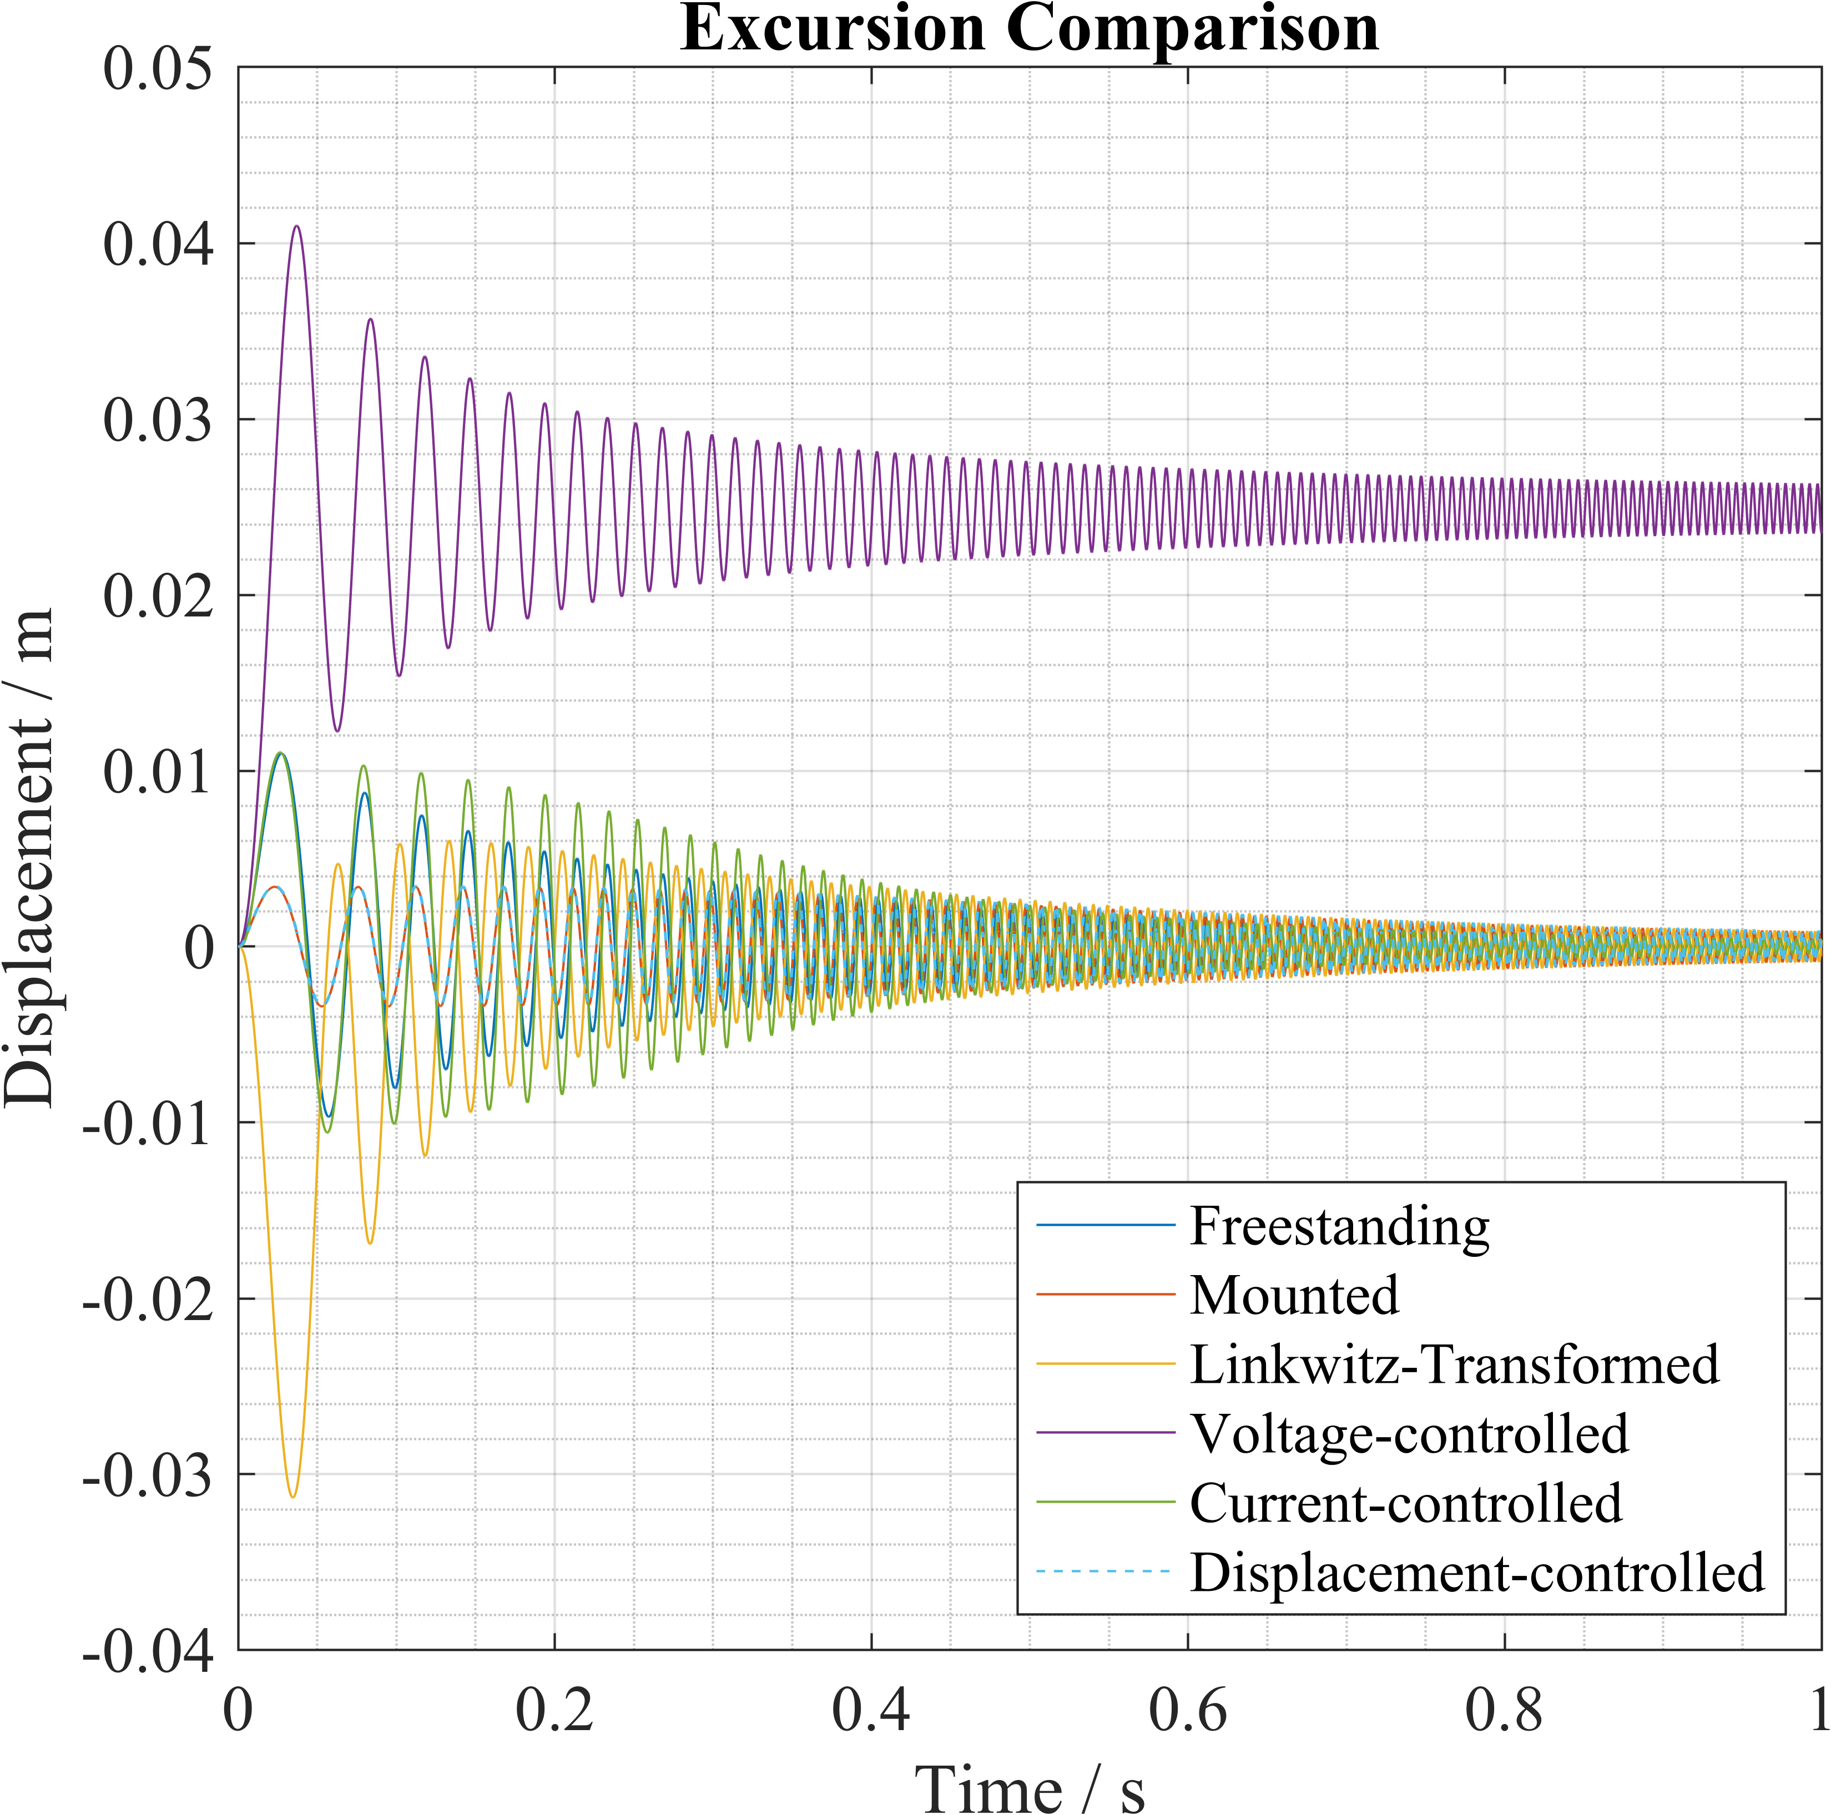

Slide 27
Conclusion
Use LT to get accurate bass, use current controller to get more bass
Results are only simulations
Result can only confidently be applied to similar subwoofers
Low price
Part success
Future work:
Build analog filters, compare to real-life subwoofer TSPs
Investigate state observers, estimators, disturbance observers to improve closed-loop controller action

